Slide 1

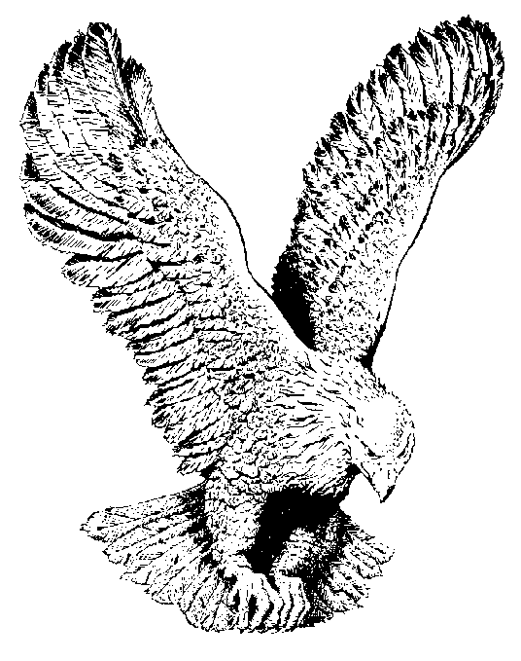
887 FAITH OF OUR FATHERS
Faith of our fa-thers! liv-ing still
Inspite of dun-geon, fire, and sword,
O how our hearts beat high with joy
When-e'er we hear that glo-rious word!
Faith of our fa-thers, ho-ly faith!
We will be true to thee till death.

Slide 2
Our fathers, chained in prisons dark,
Were still in heart and conscience free.
How sweet would be their children's fate
If they, like them could die for thee!
Faith of our fa-thers! Ho-ly faith!
We will be true to Thee till death!

Slide 3
Faith of our fa-thers! we will love
Both friends and foe in all our strife,
And preach thee, too, as love knows how
By kind-ly words and vir-tuous life:
Faith of our fa-thers, ho-ly faith!
We will be true to thee till death.

Slide 4
Faith of our fathers! God's great power
Shall win all nations unto thee;
And through the truth that comes from God
Mankind shall then be truly free.
Faith of our fa-thers! Ho-ly faith!
We will be true to thee till death!

Slide 5
Faith of our fa-thers! we strive un-to thee,
And through the truth that comes from God.
Man-kind shall then be tru-ly free,
Faith of our fa-thers, ho-ly faith!
We will be true to thee till death.

